Slide 1

SAS Datasets Comparison using R Shiny App
Presenter: Weiwei Jiao
(03/29/2024)

Slide 2
1
Introduction
2
Data Validation via SAS or R Shiny
3
Introduction to R Shiny
4
Methods of SAS Datasets Comparison using R Shiny
5
Advantage and Disadvantage of each Methods
6
Conclusion
7
References

Slide 3
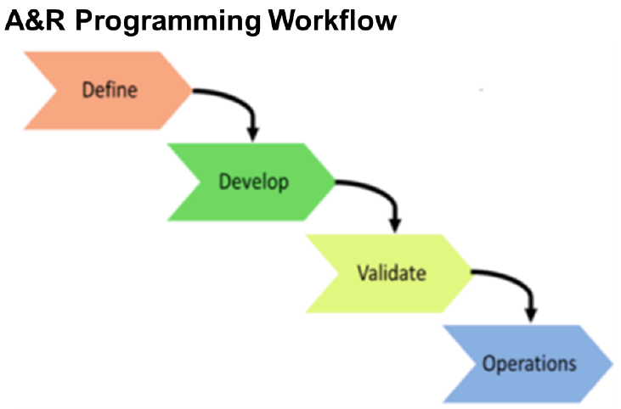
Introduction
Analysis and Reporting (A&R) is a critical process in clinical trial data analysis for programmers and statisticians. It requires careful planning to generate all A&R deliverables and follows a well-defined procedure to guarantee high quality.
Figure 1. The 4 phases of the A&R programming workflow in clinical trials.
Notes:
The define phase is a pivotal stage in the clinical trial development lifecycle, where the lead programmer and statistician collaborate with the programming team to outline the specifications for deliverables and required resources. This phase also involves planning and documenting a validation plan to ensure the quality of each deliverable.
Following the define phase, the development phase commences, where the lead programmer, in collaboration with the clinical trial team, procures necessary data for program development.
Validate phase involves the verification of programs developed in the previous phase, adhering to the validation plan and requirement specifications. This process, overseen by the lead programmer and statistician, ensures quality and regulatory compliance.
In the operations phase, the validated programs are executed using production data to produce the final deliverables. This phase also accommodates necessary updates to address new requirements or issues (Palukuru, et al., 2022).
During validate phase and operation phase, data validation from different sources or periods is a common task for both programmers and statisticians. This is essential in ensuring data integrity and accuracy.

Slide 4
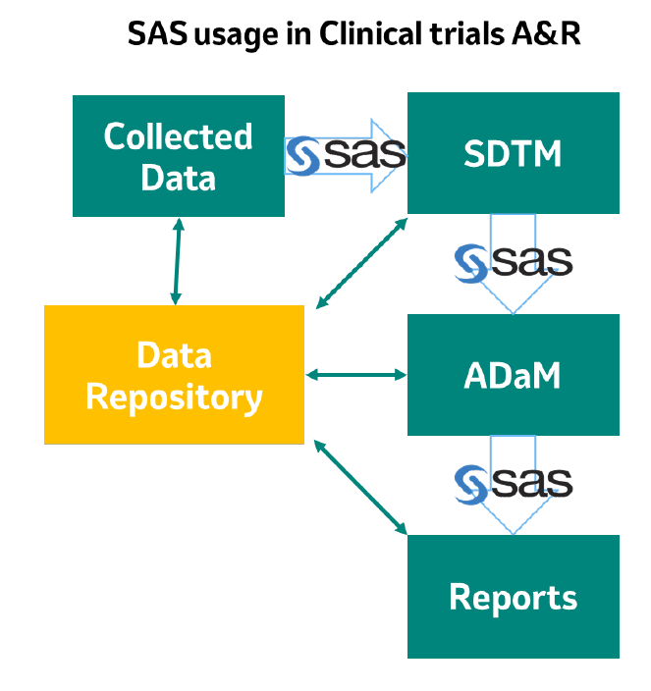

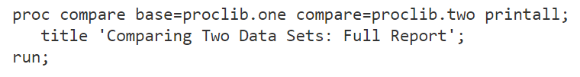
Data Validation via SAS or R Shiny
Notes:
Currently, SAS is a comprehensive software system widely used across various industries for data management, reporting, statistical analysis, and application development since late 1990s (Wang, 1996). The creation and validation of Clinical Data Interchange Standards Consortium (CDISC) datasets, specifically Study Data Tabulation Model (SDTM) and Analysis Data Model (ADaM) datasets, as well as various submission-ready reports using SAS, are the daily tasks in clinical trials analysis. Quite often, there will be multiple times of datasets comparison for one clinical trial in different study progression.
To perform data comparison in SAS, PROC COMPARE is the procedure to compare the content of two SAS datasets. By default, PROC COMPARE provides various statistics, including the number of observations compared, the number of variables compared, and a detailed listing of differences in HTML format. However, if you want to compare whether two existing SAS datasets are consistent, we need to write a proc compare program and run it for single dataset or write one macro to check multiple datasets. Although this process doesn't take too long, it is still a bit time-consuming and not intuitive enough if there are many datasets comparison needs every day.

Slide 5



Data Validation via SAS or R Shiny
Interactive Web Application
No programming skills needed
Automation
Validate data and observe changes in real-time
Save valuable time and effort, allowing programmers and statisticians to focus on more complex tasks
Multiple users can interact with the data simultaneously, making it easier to share insights and work together on data analysis.
Notes:
R Shiny is a package from R, a language and environment for statistical computing and graphics (Wickham, 2021). It allows the creation of interactive web applications directly from R. The interactivity of Shiny app enables users to provide self-service data analysis for common workflows, Users with no programming skills to make sophisticated tasks via R Shiny app.
How to utilize the benefit of R Shiny in SAS users’ daily work? For a specific data comparison task in clinical trials, the R Shiny app allows for the automation of SAS dataset comparison. It enables users to validate data and observe changes in real-time and foster a more dynamic and comprehensive understanding of the data. This capability saves programmers valuable time and effort, allowing programmers to focus on more complex tasks. This R Shiny app also facilitates collaboration among programmers. Multiple users can interact with the data simultaneously, making it easier to share insights and work together on data analysis.

Slide 6
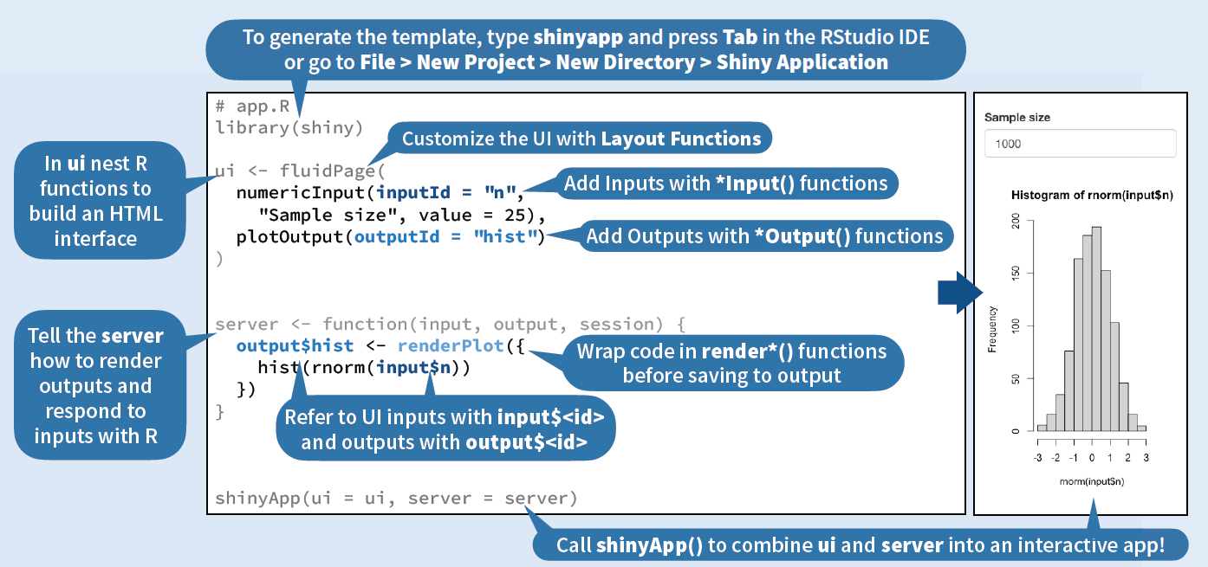
Introduction to R Shiny
Notes:
Key features of R Shiny include:
User Interface (UI): This is the layout of the application. It defines how the application looks to the user. It includes the placement of input controls, output displays, and other design elements.
Server: It contains the instructions that tell the application what to do based on the inputs it receives. It processes the user inputs from the UI and returns the output.
Reactive Programming: It allows the application to automatically update outputs when an input value changes, without the user having to manually refresh the application.

Slide 7
Methods of SAS Datasets Comparison using R Shiny – Method 1
Use internal R package for SAS dataset comparison
The app reads the datasets uploaded by the user, checks if they are in the correct format (.sas7bdat), and then compares them using the diffdf package. If there are differences between the datasets, it generates a summary of those differences.
# Compare the datasets and generate a summary table
comparison <- reactive({
if (!is.null(dataset1()) && !is.null(dataset2())) {
# Perform comparison using diffdf
diff_result <- diffdf(dataset1(), dataset2())
}
})
# Print the comparison result
output$comparisonTable <- renderPrint({comparison()})

Slide 8
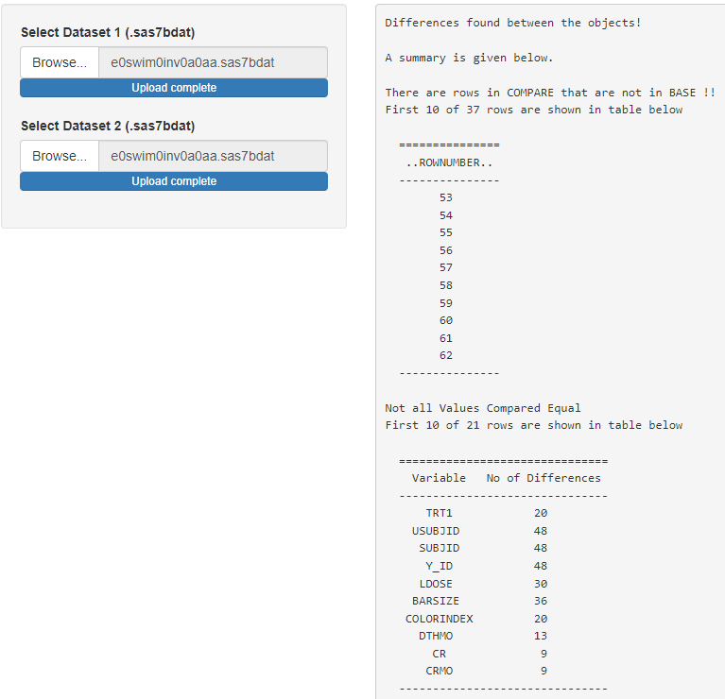
Methods of SAS Datasets Comparison using R Shiny – Method 1
Use internal R package for SAS dataset comparison
This method does not interact with SAS, and it displays the difference in default R format.
Notes:
Although this method is the simplest way to compare SAS datasets in R, its results are not as clear, intuitive, or comprehensive as the SAS compare results. HSAS users will not satisfy this format comparison results.

Slide 9
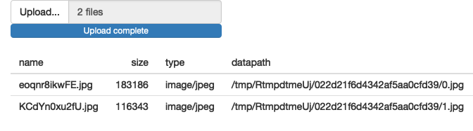
Methods of SAS Datasets Comparison using R Shiny – Method 2
Use SAS markdown for SAS dataset comparison
In the first method, we use fileInput function to upload each SAS datasets. However, fileInput function will save the file to a temporary directory and given a temporary data path to the file.

Slide 10
Methods of SAS Datasets Comparison using R Shiny – Method 2
Use SAS markdown for SAS dataset comparison
# Define rmdfile function which set up the SAS engine and create SAS proc compare SAS code
rmdfile<-function(input_base,input_compare,base,compare,out){
sas_code<-paste(
"```{r setup, include=FALSE}
library(SASmarkdown)
# Sets up the environment for running SAS code
saspath <- 'C:/Program Files/SAS94 64 Bit/SASFoundation/9.4/sas.exe'
sasopts <- '-nosplash -linesize 75'
knitr::opts_chunk$set(engine='sashtml', engine.path=saspath,
engine.opts=sasopts, comment=NA)
knitr::opts_chunk$get()$engine
knitr::opts_chunk$get()$engine.path
knitr::opts_chunk$get()$engine.opts
```",
" " ,
"```{sas}",
# SAS code to compare datasets
paste0("libname file1 \"",input_base,"\" access=readonly;"),
paste0("libname file2 \"",input_compare,"\" access=readonly;"),
paste0("proc Compare base=file1.",base," compare=file2.",compare,";"),
"run;",
"```",
sep = "\n")
# Output a RMD file
cat(sas_code, file =out)
}
The app needs to set up the environment for running SAS code within an R Markdown document.
It specifies the path to the local SAS, sets options for the SAS engine.

Slide 11
Methods of SAS Datasets Comparison using R Shiny – Method 2
Use SAS markdown for SAS dataset comparison
Upon the user's input of the base and compare dataset paths into the application, the rmdfile function is triggered. This function generates the SAS code, which is subsequently written into an RMD file. Then, the file is converted into HTML format for display within the web application.
# Part of Server to output a HTML format comparison result
output$markdown <- renderUI({
# Call rmdfile function defined previously to get SAS environment and generate a compare.Rmd file
rmdfile(input_base =path1, input_compare =path2, base=fileNames_base, compare=fileNames_comp, out= "compare.Rmd")
# Convert the Rmd file into HTML
HTML(markdown::markdownToHTML(knit('compare.Rmd', quiet = TRUE)))
})
Notes:
Below code is part of Shiny server element that add HTML output to the app:
The second method allows for the straightforward comparison of two SAS datasets by simply inputting their locations and clicking a button to generate a clear and concise SAS compare result. However, it necessitates the user to have local SAS installed. And a RMD file will be saved while comparison.

Slide 12
Methods of SAS Datasets Comparison using R Shiny – Method 3
Connect to server SAS via secure shell (SSH) for dataset comparison
The app starts with generating a SAS program in user defined study folder, which incorporates sets up the study working path and proc compare SAS programs.
Then, the app utilizes SSH::ssh_connect() function to establish an SSH connection from R to the remote SAS sever. Users are required to log in with a password, and once authenticated, the app submits a command to execute the SAS program. SSH::ssh_exec_wait() function is used to submit the command and wait for it to finish before closing the connection.
# Set the command to execute the SAS program
command <- paste0('sas94 ', sas_file())
# Connect to the remote server via SSH using the ssh package
session <- ssh_connect("remote server", passwd=l$pwd)
# Submit the command to execute the SAS program and wait for it to finish
ssh_exec_wait(session, command = command)
# Disconnect the SSH connection
ssh_disconnect(session)
Notes:
Recognizing that not all potential users will have local SAS installed, we have devised a new method involving the linkage to a server SAS. The app starts with generating a SAS program in user defined study folder, which incorporates sets up the study working path and proc compare SAS programs.
This method does not require SAS to be installed locally. However, it will generate a SAS program every time while performing the comparison. This output SAS program is not necessary since it is difficult to explain this redundant SAS program during a clincal trial audit.

Slide 13
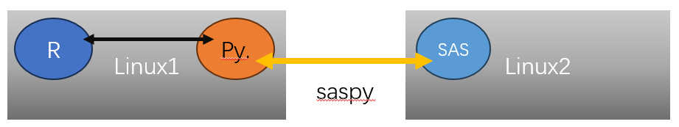
Methods of SAS Datasets Comparison using R Shiny – Method 4
Connect to server SAS via python for dataset comparison
The app first extracts the corresponding folder path and dataset name based on the user's input in UI panel, then generates a temporary proc compare SAS code. Then, it connects to the remote SAS server via httr::POST function to run this temporary SAS code, outputting the results in HTML format.
result<-reactive({
# Input SAS code, user ID, password, output HTML result
info<-list(sascode=code,isid=input$isid,pwd=input$password,loglst="lst",result_type="HTML")
# Connect to server SAS via python
res <- httr::POST("serversas website", body = info)
a<-rawToChar(res$content,multiple=TRUE)
b<-paste(a,collapse="")
})
# Display HTML format result
output$comp <- renderUI({HTML(result())})

Slide 14
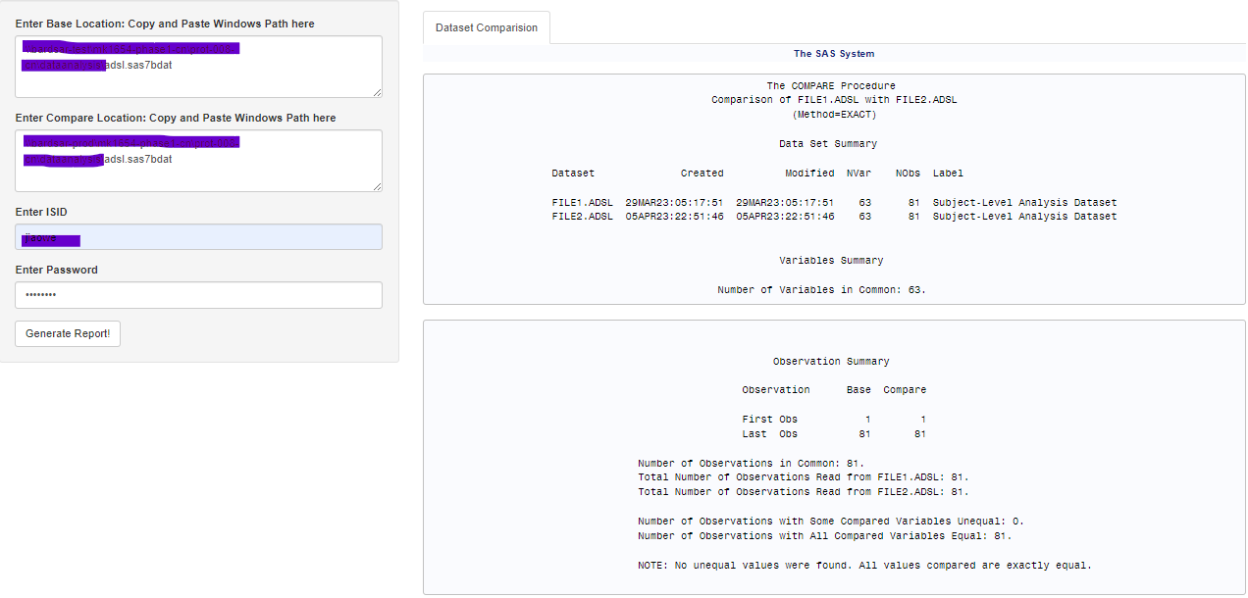
Methods of SAS Datasets Comparison using R Shiny – Method 4
Connect to server SAS via python for dataset comparison
Notes:
This method does not require the user to install local R or local SAS, it only needs to go through a webpage, enter the location of the two datasets that need to be compared and user ID and password. Then this app will connect to the server SAS via python in the background, to carry out the SAS dataset comparison, and display a concise and clear SAS compare result. This workflow uses less resource than a comparable SAS program to compare datasets. Thus, R shiny app can be used as a validation tool to increase efficiency and to automate the validation process.

Slide 15
Advantage and Disadvantage of each Methods
Method | Advantage | Disadvantage
Internal R package | 1. Simple Code 2. Upload SAS datasets using browse 3. Local SAS or server SAS is not involved | 1 The comparison result is not user-friendly as SAS format comparison result.
SAS markdown via local SAS | 1. Results are user-friendly in SAS format. | 1. A new RMD file will generate. 2. Local SAS needed.
Connect server SAS via SSH connection | 1. Results are user-friendly in SAS format. 2. Local SAS is not needed. | 1. A SAS program needs to be generated in advance. 2. User ID and password are needed for server SAS.
Connect server SAS via Python | 1. Results are user-friendly in SAS format. 2. Local SAS is not needed. | 1. User ID and password are needed for server SAS.
Notes:
This method does not require the user to install local R or local SAS, it only needs to go through a webpage, enter the location of the two datasets that need to be compared and user ID and password. Then this app will connect to the server SAS via python in the background, to carry out the SAS dataset comparison, and display a concise and clear SAS compare result. This workflow uses less resource than a comparable SAS program to compare datasets. Thus, R shiny app can be used as a validation tool to increase efficiency and to automate the validation process.

Slide 16

Conclusion
SAS and R, both utilized by numerous organizations, offer tools for clinical trial data validation. Despite SAS being the conventional preference for many years, the rise of R as an open-source software platform is broadening its application.
We investigated various methods utilizing the R Shiny app as a dataset validation tool.
R Shiny app automates SAS dataset comparison, conserving significant time and effort for programmers and statisticians. This efficiency boost enhances productivity, enabling programmers to concentrate on other pivotal tasks.

Slide 17

Reference
Nepal, S., Palukuru, U. P., Wu, P., Ginnaram, M., Patel, R., Chimbirithy, A. V., . . . Zhang, Y. (2021). Agile Project Management in Analysis and Reporting of Late Stage Clinical Trials. PharmaSUG, SI-083. https://www.pharmasug.org/proceedings/2021/SI/PharmaSUG-2021-SI-083.pdf
Palukuru, U. P., Li, R., Patel, N., & Shi, C. (2022). Exploring R as a validation tool for statistical programming in clinical trials. PharmaSUG, AD-076. https://www.pharmasug.org/proceedings/2022/AD/PharmaSUG-2022-AD-076.pdf
Wang, M. (1996). The Role of SAS Programmers in Clinical Trial Data Analysis. NESUG 96 Proceedings. Industry Applications, pp. 330-335. Boston: NESUG. https://www.lexjansen.com/nesug/nesug96/NESUG96061.pdf
Wickham, H. (2021). Mastering shiny. " O'Reilly Media, Inc.".
https://mastering-shiny.org/action-transfer.html
Pang, L., Gao, B. (2023). A Shiny App for Clinical Data Check. PharmaSUG China, AA-132.
https://pharmasug.com.cn/resources/2023/2023-08/Pharmasug-China-2023-AA132.pdf

Slide 18

Thank you

